Slide 1
PDF Downloader
By Niharika Dusa

Slide 2
Overview of the tool
The tool downloads the pdf files from the urls in CSV file.
It checks the link in second column and third column, if the url downloads then it generates excel with columns id, url links status filepath and date of the download.

Slide 3
Technologies used
Programming language
  Python
environment
  Conda Environment, VS Code

Slide 4
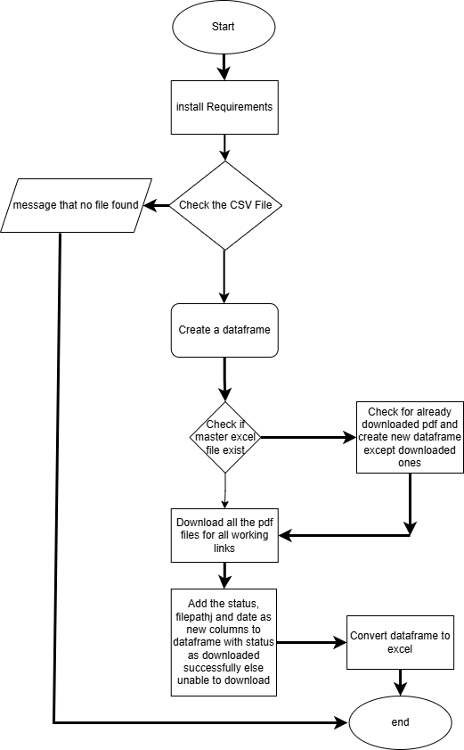
Flow chart

Slide 5
Files
Requirements.txt
Pythonimports.py
Utils.py
Main.py
Readme.md

Slide 6
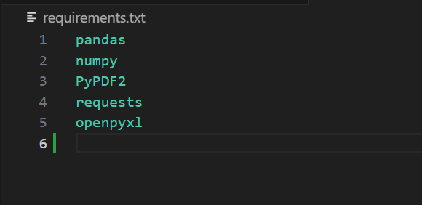
Requirements.txt
This files have some prerequisite installations for the tool to run .
eg: Pandas, numpy,pyPDF2, requests etc

Slide 7
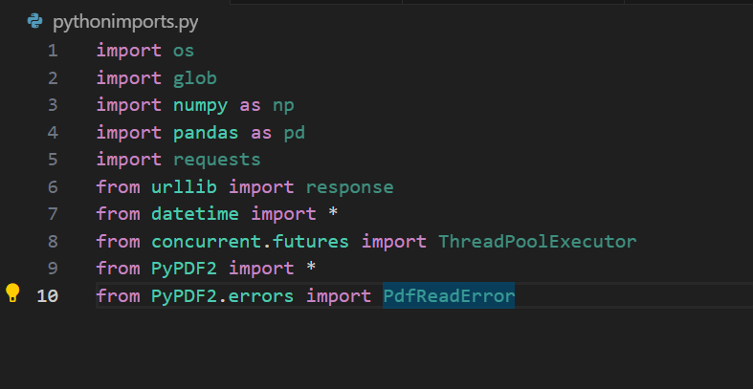
Pythonimports.py
This file has all the code for imported packages.

Slide 8
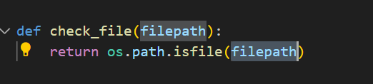
Checkfile()
This function check if the uploaded document is there in the file path or no.

Slide 9
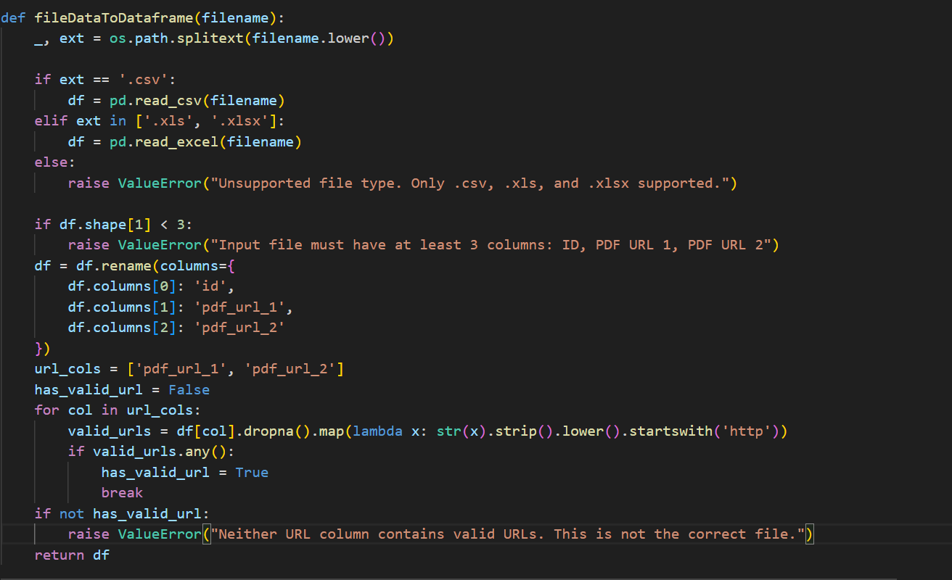
Filetodataframe()
This function convert the csv file data into a dataframe(a structured table).

Slide 10
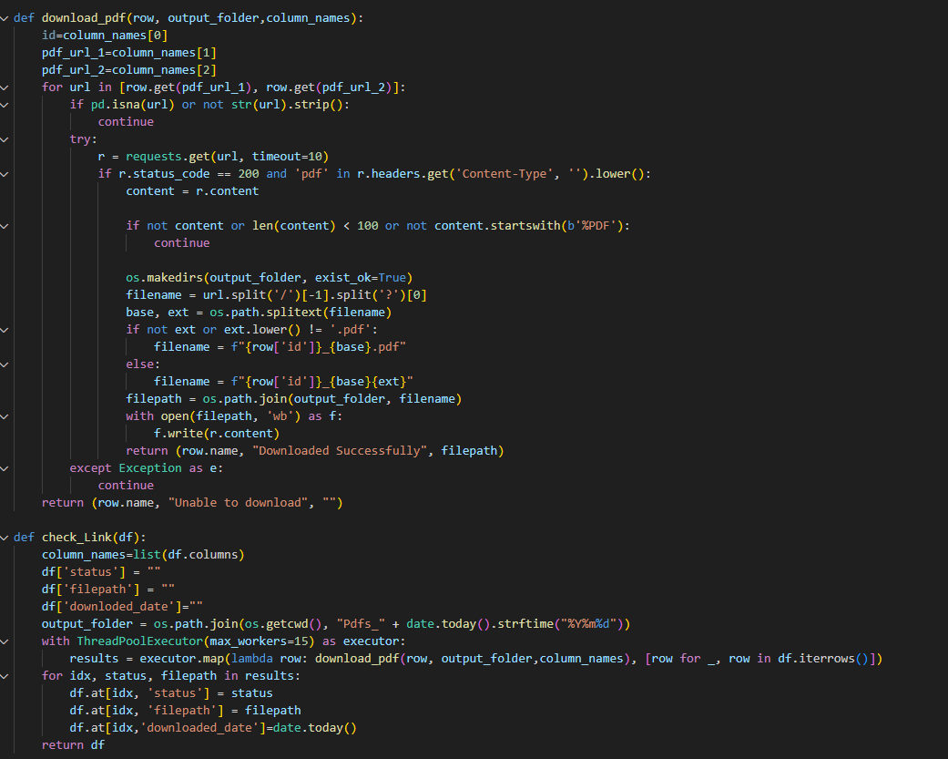
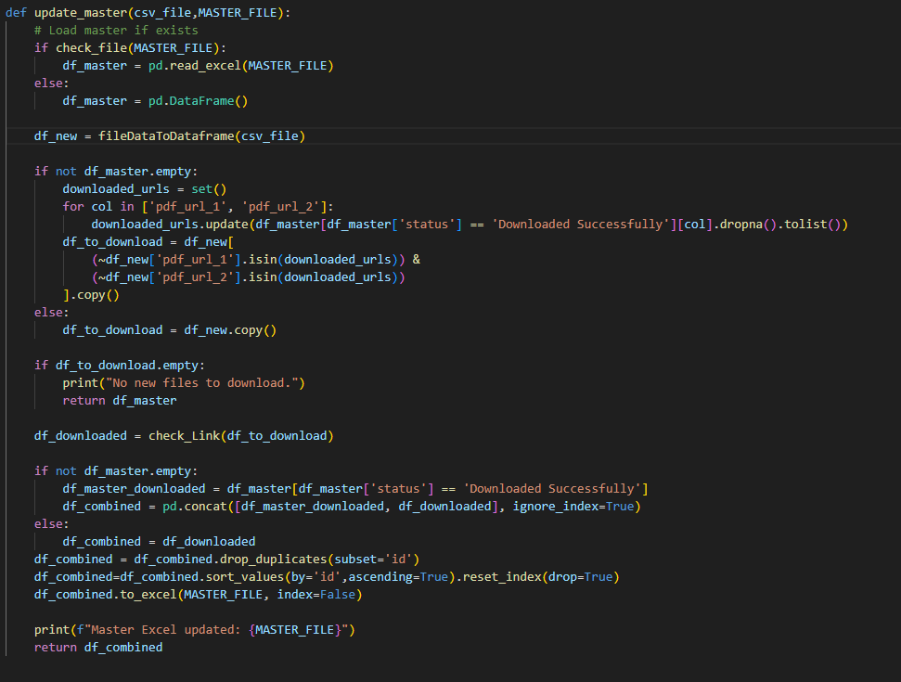
Downloding pdfs
I have 3 functions to download PDF’s
Update_master()
Check_link()
Download_url()

Slide 11
Download PDF’s
The Master Excel file contains 6 columns, idnumber, 2 columns with urls, status for download, path of the pdf, and date.
The tool also checks and deletes pdf that are not working and empty.

Slide 12
Git Hub
The all files have been pushed to github.
There is a readme file where all instructions are clearly mentioned for the non technical user to access the tool.
Link to GitHub repository:
https://github.com/Niharikadusa/PDF_downloader_automatic

Slide 13
Things couldn’t be implemented
The tool has not frontend, where user can upload and download the documents.

Slide 14
Questions ?

Slide 15
Thank you

